Slide 1


Presentation
Skills Workshop

Slide 2
What Makes An Effective Presentation ?

Slide 3
What Makes An Effective Presentation ?
The 3 Kings of the Presentation Triangle
Content
Cosmetics
Presenter

Slide 4
The Presentation Triangle !
Content
Cosmetics
Presenter

Slide 5
What is Content?
“Anything and Everything that Contributes to your Presentation Goals cane be defined as a Content”

Slide 6
What is my Presentation Goal?
How Do I Define My Presentation Goals?

Slide 7
Ask Yourself 2 Questions!
Why am I making this Presentation?
Who am I making this presentation to? Who’s my audience?
Note: The Nature of Your Audience will Determine Your Content Selection….such as
Age Group
Demographics
Backgrounds
Education
Profession

Slide 8
Preparing a Presentation
Defining Your Purpose
Clarifying Objectives
Finding Material
Structuring Material
Knowing Your Audience
Writing A Presentation
Knowing Your Venue

Slide 9
Ask Yourself - Why am I going to give this presentation?
To provide information
To represent my function / organization
To entertain
To fill up the agenda
To sell my ideas
To get a commitment from the audience

Slide 10
The “Golden Rule” !
“At Least 2 Hours of Research for 5 Minutes of Presentation”

Slide 11
So! What Can be considered as a Content?
Index | Table of Content
Quotations
Proverbs
Newspaper Clippings/Cuttings
Testimonials
Data
Reports
Statistics
Numbers
Multimedia – Audio/Video files
Articles
Reports
Research Data
Surveys
Source
Images
Photographs
Graphs
Charts
many More……!
Tip! It takes Extensive Research, Authenticity, Genuineness and Credibility of your Content to make a successful presentation

Slide 12
Assignment - 1
You have been assigned to make a Presentation on
E-Learning Vs Classroom Learning, Research Your Appropriate Content On a Comparative Study

Slide 13
Assignment - 2
You have been assigned to make a Presentation on
Work From Home Vs Work From Office .Research Your Appropriate Content On a Comparative Study

Slide 14
Introduction to “Cosmetics”
What Comes to Your mind?

Slide 15
Introduction to “Cosmetics”
“Refers to the Arrangement, Alignment, Decoration and Placement of Your Content at the Appropriate Positions and Places and at the Right “Time”

Slide 16
Introduction to “Cosmetics”
Index | Table of Content
Font ( Size, Types, Colors )
Headers ( Size, Types, Colors )
Sub- Headers ( Size, Types, Colors )
Bold
Italics
Underline
Strikethrough
Graphics
Use of Animation | Slide Transitions
Cliparts
Glossary
Library Links

Slide 17
Introduction to “Cosmetics”
Index | Table of Content
Introduction
Body
Evaluations | Practice Exercises | Teach backs
Summary
Recap
Conclusion

Slide 18
Introduction to “Cosmetics”
Introduction – “Tell Them What You are Going to tell Them”
Body – “Tell Them”
Conclusion “ tell them, what you have told Them”

Slide 19

Steps to a Successful and Effective Presentation
Preparing A Presentation
Preparing Yourself
Handling An Audience
Presentation Aids

Slide 20
The 3 ES Approach
Educate
Entertain
Explain

Slide 21

Finding Material
Careful background research.
Exhaust as many resources as possible to find information.
Thumb Rule - 1 hour should be spent in preparation for 5 minutes of talking.
Keep your main objectives in mind while researching your material.

Slide 22
Structuring Material
Introduction
Body
Conclusion
Tell them what you
are going to tell
them
Tell them
Tell them what you
have told them

Slide 23
Introduction
It is imperative to plan your beginning carefully; there
are 4 main elements -
Get their attention
Establish a theme
Present a structure
Create a rapport

Slide 24
Reasons to use an Introduction
Gets the audience’s attention
Introduces the topic
Shows the topic’s importance
Presents the thesis
Forecasts the major ideas

Slide 25
Main Body
Examples
Definitions
Testimonies
Support
Main
Points
With
Explanations
Demonstrations
Facts
Statistics
Creates understanding
Creates belief
Provides relevance and significance

Slide 26
Conclusion
Inform the audience that you are about to close
Summarize the major ideas
Leave the audience with an idea to remember

Slide 27

Writing a Presentation
Must Know
Should Know
Nice to Know

Slide 28
Writing A Presentation
When you build your presentation think about the following tips :
Title each screen
Use larger fonts and perhaps different style / colours for titles
Don’t use too many colours / fonts
Stick to one font with different sizes and styles ( Bold, Italics )
All screens must be simple and clear

Slide 29
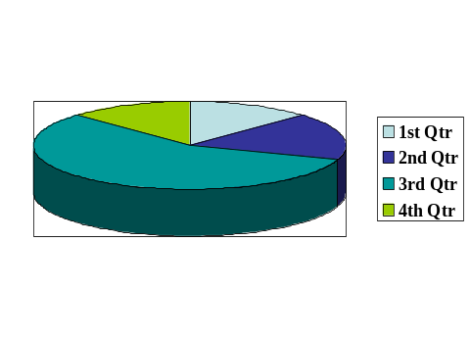
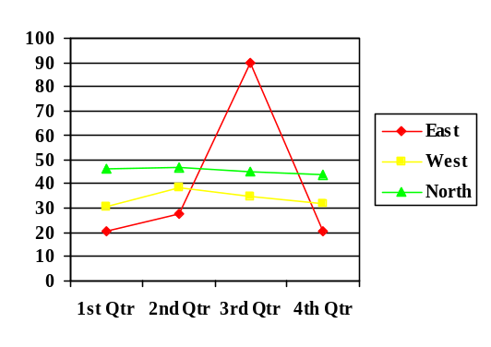
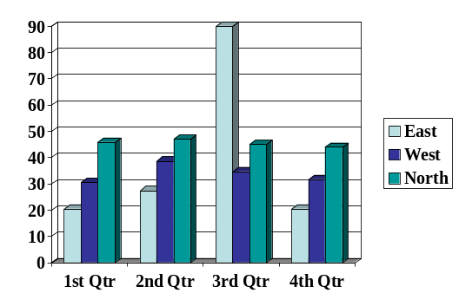
Writing A Presentation (contd.…)
Use pie charts for comparison of components
Use line charts to show trends
Use bar charts to do both

Slide 30
Writing A Presentation (contd.…)
No more than six bullet points per slide
Use graphics symbols where possible to show ideas
Use lots of white space on screen
Try it out before, e.g. Rehearse - is monitor big enough ?
Order points by order of importance - most important first
For impact - combine sound, image and motion ( multimedia )

Slide 31
Do’s of Writing a Presentation
Do use simple, direct, sentences.
Do use the pronouns “you” and “I”.
Do sprinkle your speech liberally with adjectives.
Do prepare and rehearse phrases to avoid stumbling.
Do include examples and analogies to illustrate your points.

Slide 32
Don’ts of Writing a Presentation
Don’t use jargon or inappropriate language.
Don’t fill your speech with irrelevant points.
Don’t feel that you have to write out the speech word for word.
Don’t overwhelm the audience with too much detail.
Don’t patronize your audience.
Don’t try to imitate someone else’s style; it will sound false.

Slide 33
Knowing Your Audience
What is the expected size of the audience ?
What is the average age of the audience ?
Is the audience well informed about your topic ?
What do the members of the audience have in common ?
What is the cultural make-up of the audience ?
Does everyone or anyone in the audience know you or do they know each other ?
What is the background of the audience ?

Slide 34
Knowing Your Venue
Keep area around doorway clear for easy entry and exit.
Locate power points, and check whether you need extension leads.
Locate light switches so that if necessary, you can dim the lights to use
your visual aids.
Decide on the positioning of any visual aids well in advance.
Position refreshments at the rear of the venue to avoid possible distractions.
Ask somebody to check if they can hear you at the back.

Slide 35
“He who fails to prepare;
is preparing for failure - so
Prepare, Prepare, Prepare”

Slide 36

Presentation Aids
Audio Visual Aids
Leave Behinds

Slide 37
Why Use Visual Aids ?
Visual Aids enhance understanding of the topic.
Visuals Aids add authenticity.
Visual Aids add variety.
Visual Aids help your speech have lasting impact.
Visual Aids can help the speaker build ethos ( speaker character credibility).

Slide 38
Using Your Visual Aid Successfully
Practice. Make sure Visual Aid is integrated into your speech.
Plan placement of Visual Aid prior to the speech.
Check to see that your electronic equipment is running, and that you know
how to properly operate it.
Do not stand directly in front of it, stand to the side and face the audience
as much as possible.

Slide 39
Using Your Visual Aid Successfully ( contd.…)
When referring to the Visual Aid, point, don’t leave your audience searching.
Do not distribute materials during your speech. If you have prepared handouts,
distribute them before or after you speak.
The key to creating successful visuals is not to cram too much onto a single
slide. Each slide should contain no more than one simple graph or chart, or
six short lines of copy.

Slide 40

Leave Behinds ….
A leave-behind is a document you distribute to your
audience as a permanent reminder of your talk.
The leave-behind is usually a bound booklet containing copies of the
visuals or a reprint of the speech.
If you intend to distribute a leave-behind, say so before you begin your talk.
That way, the audience knows they don’t have to take notes and they can sit
back, relax,and enjoy the speech. But don’t hand out the leave-behind until
after the presentation. If you distribute it before or during the talk, people
will read the leave-behind and ignore the speaker - YOU.

Slide 41
What Fortune 500 Executives Say….
Know your own purpose and make sure it fits reality
Identify the fundamental messages and key points you want
to get across
Believe that what you have to say is important
Know your audience
Give a time - pressed audience an introductory capsule summary
of your presentation
Adjust your presentation to fit a changing situation and audience needs

Slide 42
What Fortune 500 Executives Say….
Be prepared for material that is not in your presentation
Make sure visual aids can be read and keep them simple
Prepare well and pay attention to details
Practice, improve through study of good techniques and evaluation
Put on a show - the presentation has to be interesting and exciting
Keep your perspective - don’t take the presentation too seriously
and enjoy every bit

Slide 43
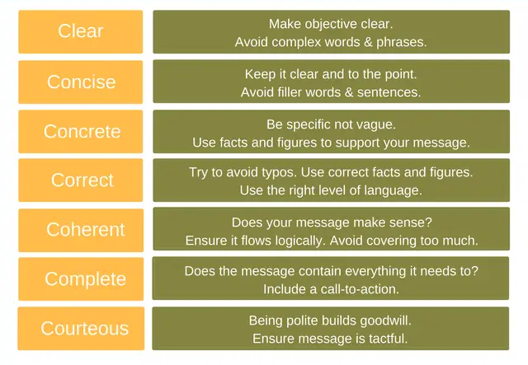
The “7C(s) of Presentation Checklist!

Slide 44

Questions

